Slide 1
PySide2 tutorial
Create GUI applications with Python

Slide 2
Training Outline
Getting started with PySide
Creating applications with Qt Designer
Custom Widgets
QtQuick & QML

Slide 3
Getting started with PySide
Creating your first app with PySide2
PySide2 Signals, Slots & Events
PySide2 Widgets
PySide2 Layouts
PySide2 Dialogs and Alerts
Creating additional windows

Slide 4
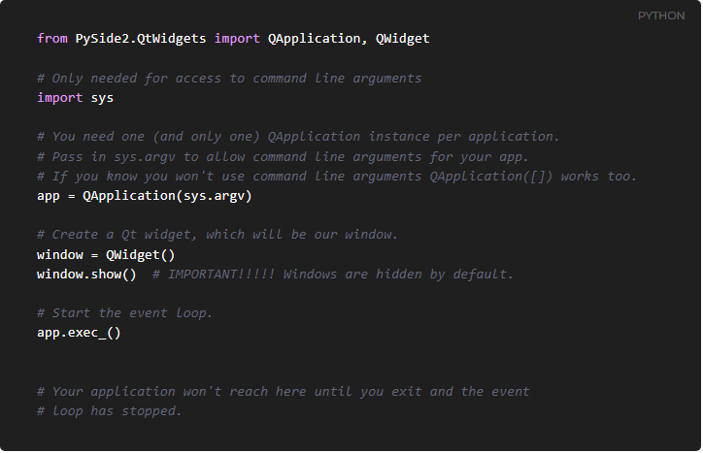
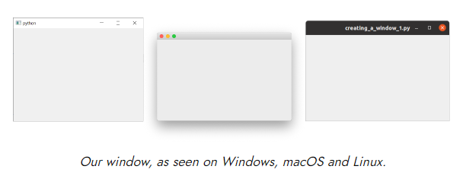
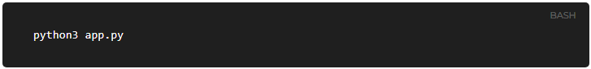
Creating your first app with PySide2

Slide 5
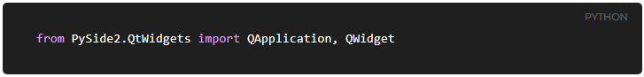
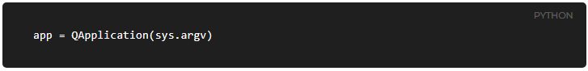
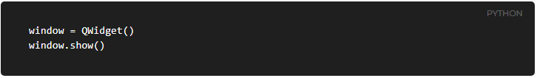
Stepping through the code
The main modules for Qt are QtWidgets, QtGui and QtCore.
Next we create an instance of QApplication
Next we create an instance of a QWidget using the variable name window.
Finally, we call app.exec_() to start up the event loop.
In Qt all top level widgets are windows -- that is, they don't have a parent and are not nested within another widget or layout. This means you can technically create a window using any widget you like.

Slide 6
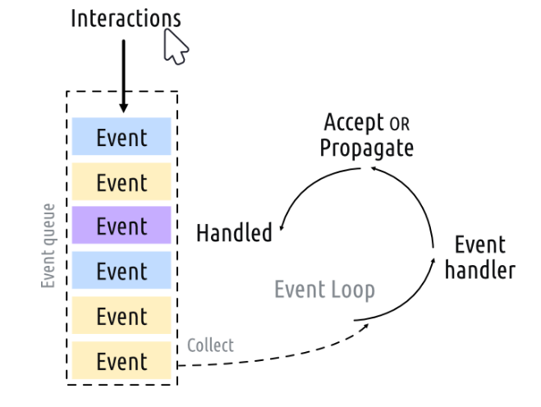
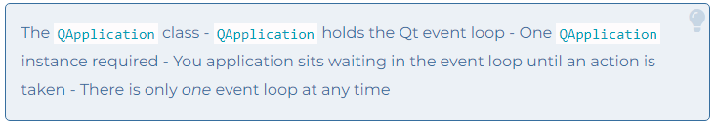
Stepping through the code

Slide 7
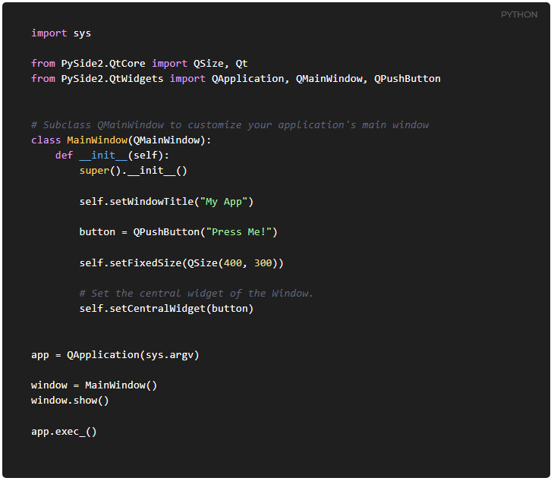
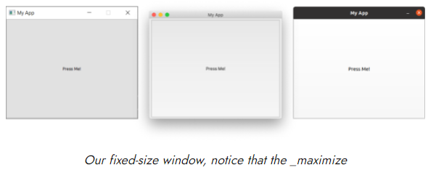
QMainWindow
The QMainWindow is a pre-made widget which provides a lot of standard window features you'll make use of in your apps, including toolbars, menus, a statusbar, dockable widgets and more. We'll look at these advanced features later, but for now, we'll add a simple empty QMainWindow to our application.

Slide 8
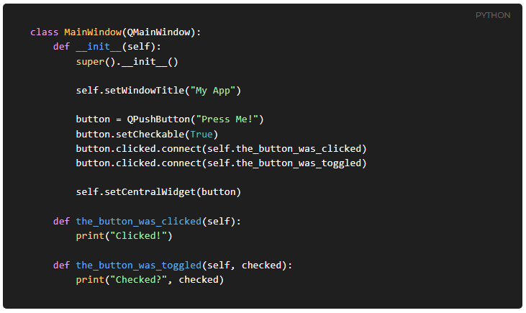
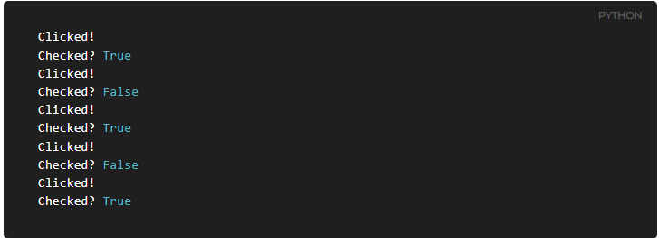
PySide2 Signals, Slots & Events
Signals are notifications emitted by widgets when something happens. Many signals are initiated by user action, but this is not a rule.
Slots is the name Qt uses for the receivers of signals, simply by connecting the signal to it. If the signal sends data, then the receiving function will receive that data too.

Slide 9
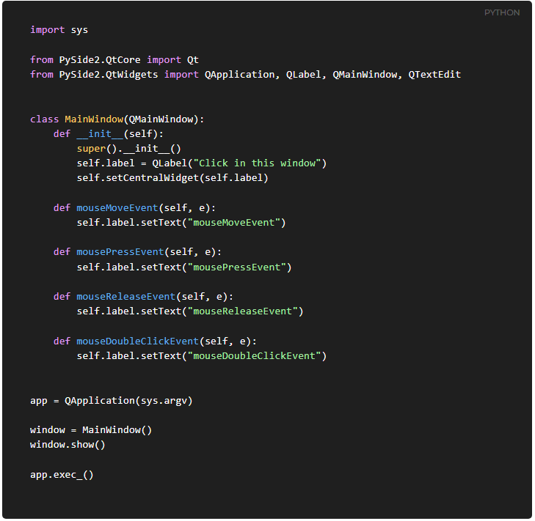
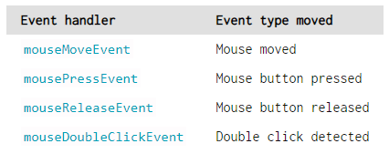
PySide2 Signals, Slots & Events
Events Every interaction the user has with a Qt application is an event. There are many types of event, each representing a different type of interaction.

Slide 10
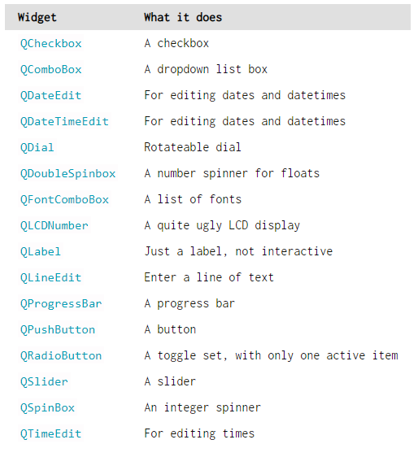
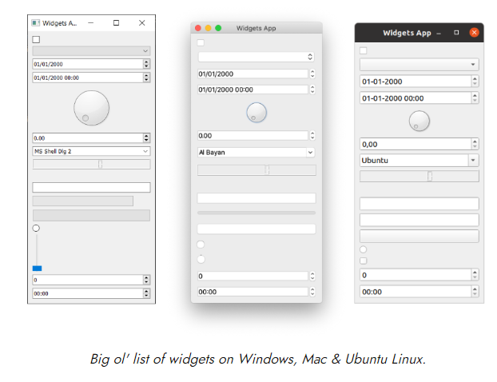
PySide2 Widgets

Slide 11
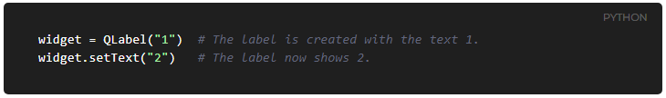
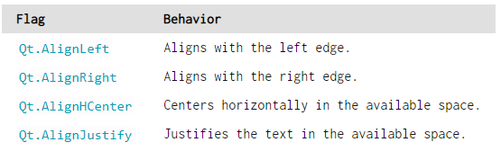
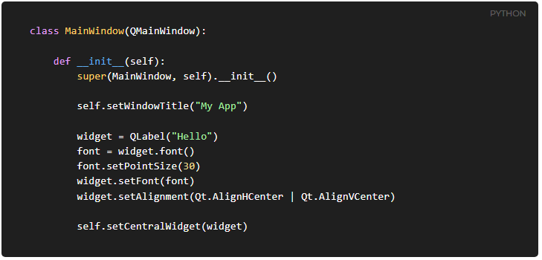
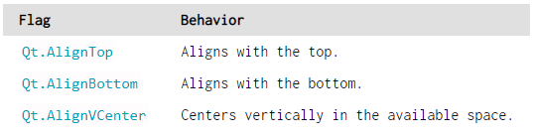
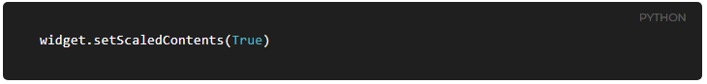
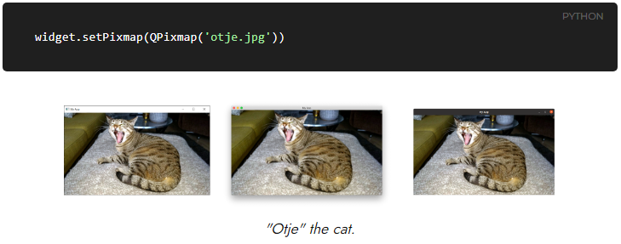
QLabel

Slide 12
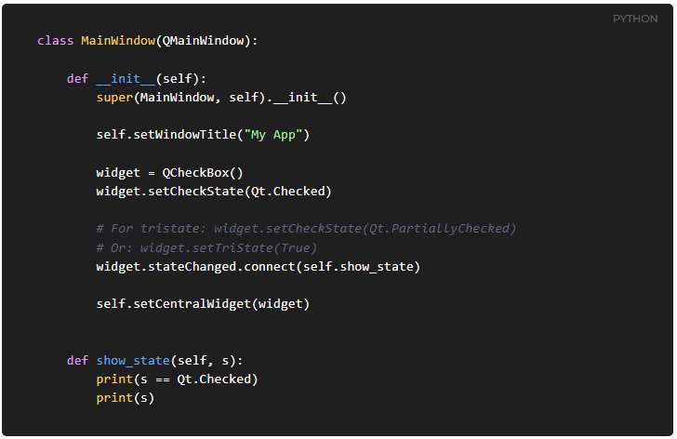
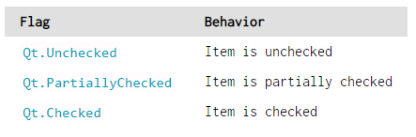
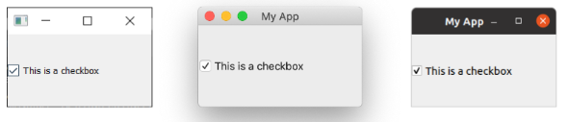
QCheckBox

Slide 13
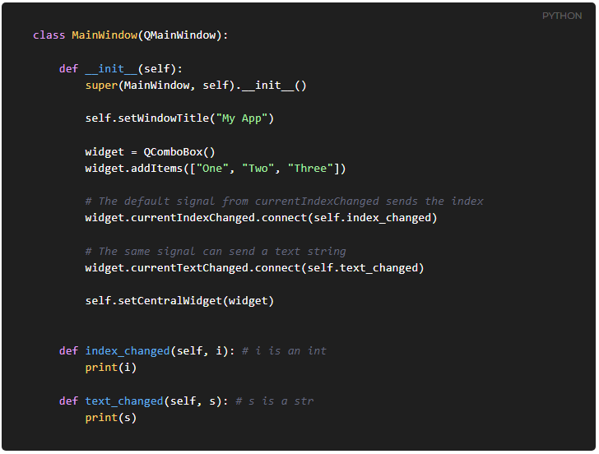
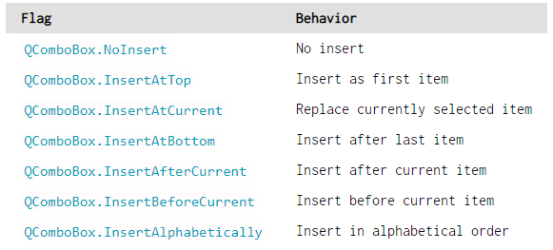
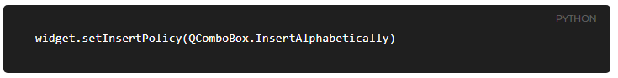
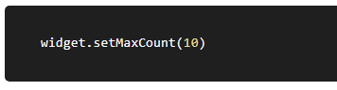
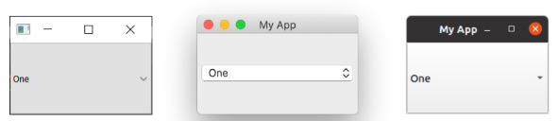
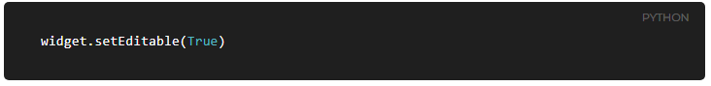
QComboBox

Slide 14
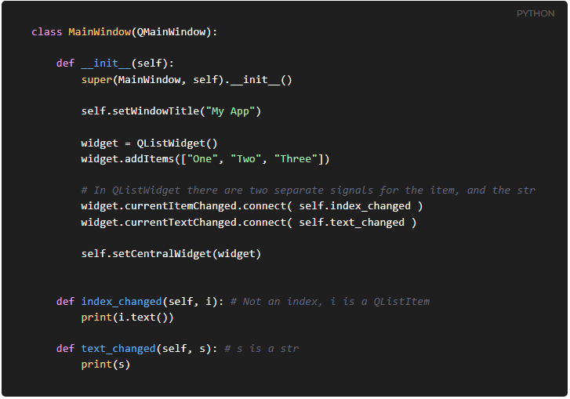
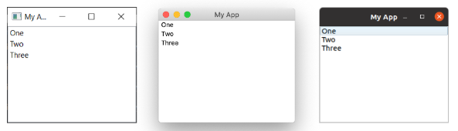
QListWidget

Slide 15
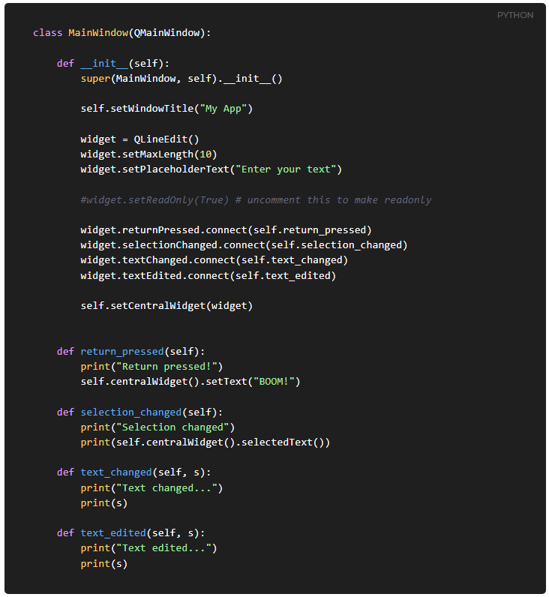
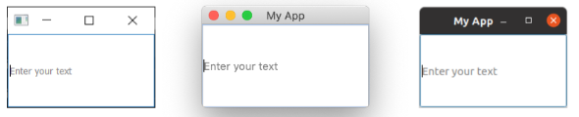
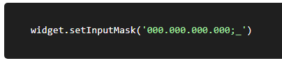
QLineEdit

Slide 16
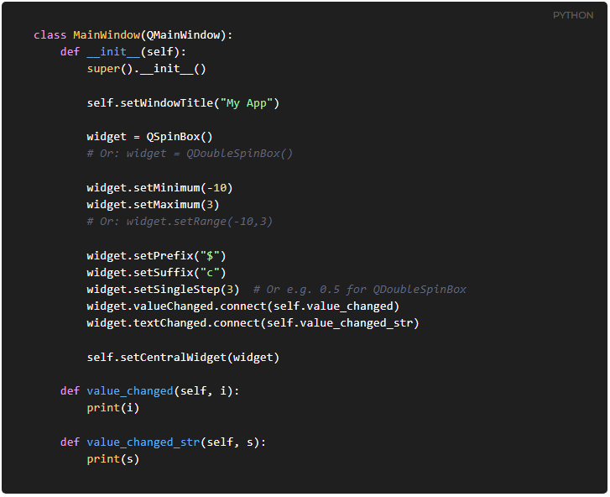
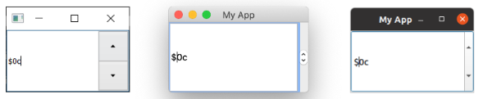
QSpinBox and QDoubleSpinBox

Slide 17
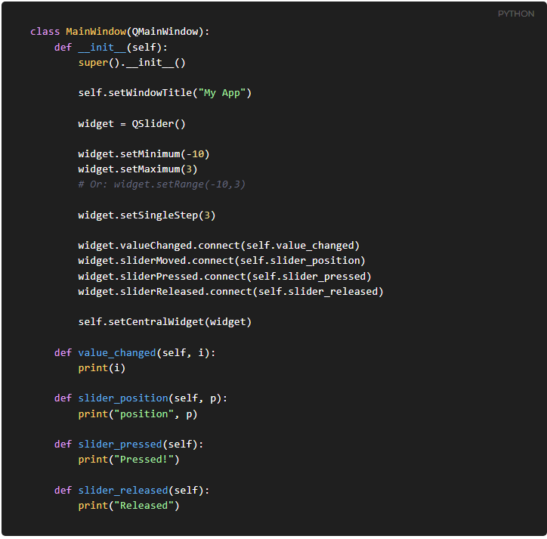
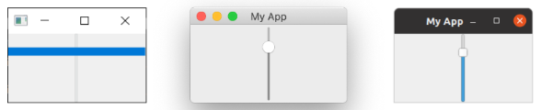
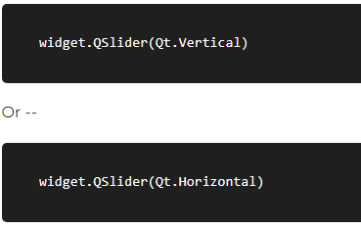
QSlider

Slide 18
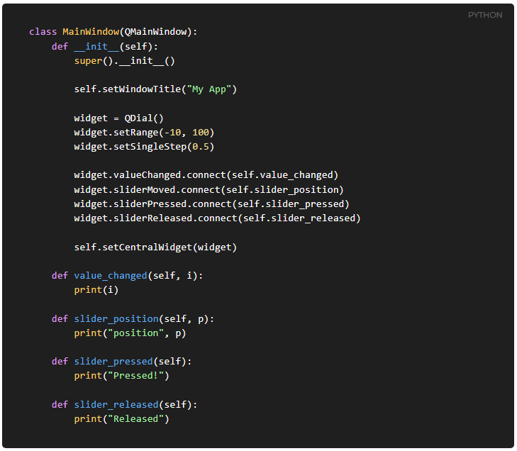
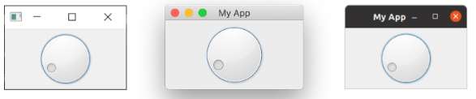
QDial

Slide 19
PySide2 Layouts
QVBoxLayout
QHBoxLayout
Nesting layouts
QGridLayout
QStackedLayout
QTabWidget

Slide 20
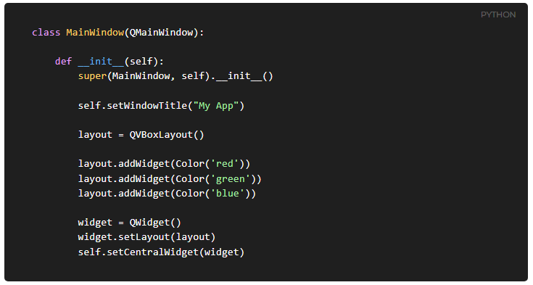
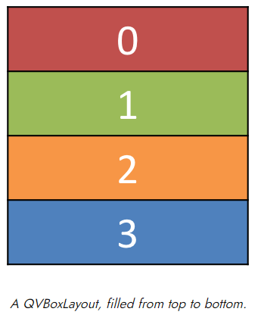
QVBoxLayout vertically arranged widgets

Slide 21
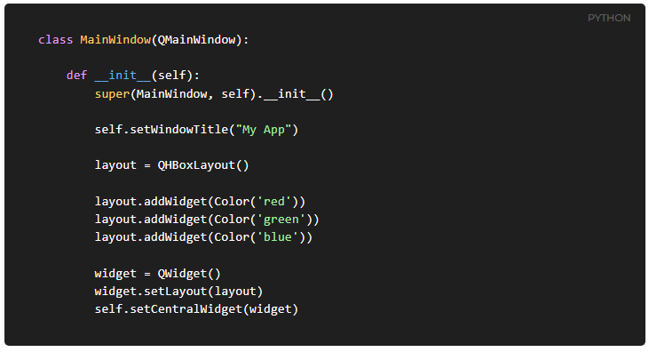
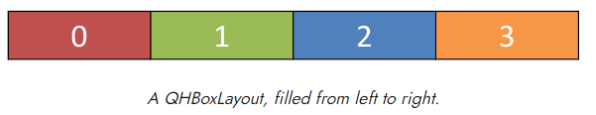
QHBoxLayout horizontally arranged widgets

Slide 22
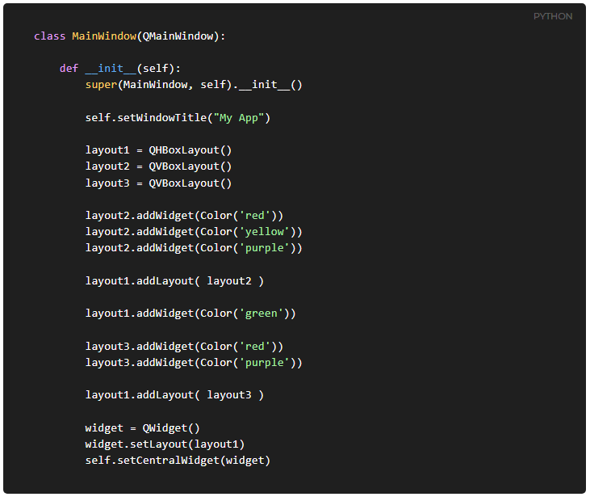
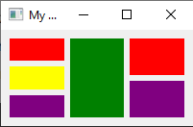
Nesting layouts

Slide 23
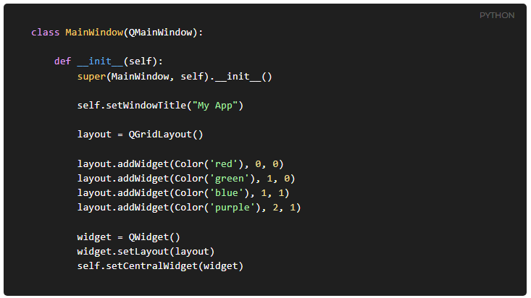


QGridLayout widgets arranged in a grid

Slide 24


QStackedLayout multiple widgets in the same space

Slide 25



QTabWidget

Slide 26
PySide2 Dialogs and Alerts
QDialog
QMessageBox

Slide 27




QDialog

Slide 28





QMessageBox

Slide 29



Built in QMessageBox dialogs

Slide 30


Creating additional windows

Slide 31
Creating applications with Qt Designer
First steps with Qt Designer
The QResource System

Slide 32




Using Designer in Qt Creator

Slide 33
Using Designer in Qt Creator

Slide 34




Laying out your Main Window

Slide 35
Using your generated .ui file
The .ui file is in XML format. To use our UI from Python we have two alternative methods available —
load into into a class using the .loadUI() method
convert it to Python using the pyside2-uic tool.

Slide 36


Loading the .ui file directly

Slide 37

Converting your .ui file to Python
$ pyside2-uic mainwindow.ui -o MainWindow.py

Slide 38


The QResource System

Slide 39


The QResource System

Slide 40
Custom Widgets
QPainter and Bitmap Graphics
Creating custom GUI widgets in PySide2
Animating custom widgets with QPropertyAnimation

Slide 41



QPainter and Bitmap Graphics

Slide 42
Drawing primitives
drawLine
drawPoint
drawRect, drawRects and drawRoundedRect
drawEllipse
drawText

Slide 43



Creating custom GUI widget

Slide 44
Creating custom GUI widget
Outline widget
Test import and display widget
Using paintEvent to render widget component
Updating the display
Trigger or Refresh widget by connect signal and slot
Create methods and properties for the events of change

Slide 45


Animating custom widgets with QPropertyAnimation

Slide 46
QtQuick & QML
Create applications with QtQuick
Animations and Transformations with QtQuick

Slide 47


Create applications with QtQuick

Slide 48



Updating our app time display

Slide 49




Using signals

Slide 50



Using signals

Slide 51


Animations and Transformations

Slide 52

Removing the window decorations and Transparent background

